Slide 1
Social Media impact on work
BY Loveneet, Ranjeet, Prabhjot & ketandeep

Slide 2
INTRODUCTION
Co-operation and harmony = better productivity and functioning
Communication among colleagues via social media
Social media has two perspectives
Knowledge or information
Unusual messaging

Slide 3
REPORTS
&
SURVEYS
RESULTS

Slide 4
Which of the following groups engage in social media activities on behalf of your organization to reach external audiences?
Note: n = 322. Respondents who indicated their company does not engage in social media activities were exclude from this analysis. Total does not equal 100% because respondents were able to select multiple response options.

Slide 5
Which of the following social networking services or multimedia platforms does your organization use to reach external audiences?
 | Percentage
Facebook | 45%
LinkedIn | 34%
Twitter | 28%
YouTube | 18%
Photo-sharing applications | 8%
Video-sharing sites other than YouTube | 7%
MySpace | 4%
Foursquare | 2%
Second Life | 1%
Other | 1%
Note: n = 532. Total does not equal 100% because respondents were able to select multiple response options.

Slide 6
Advantages
Positive consequences
Sharing information
Social Interaction

Slide 7
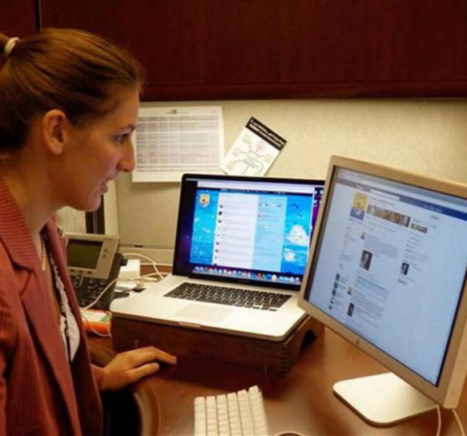
Useful Features
Relaxation of mind
A source of applying job

Slide 8
Disadvantages
Distraction
Wrong Use
Health Issues

Slide 9
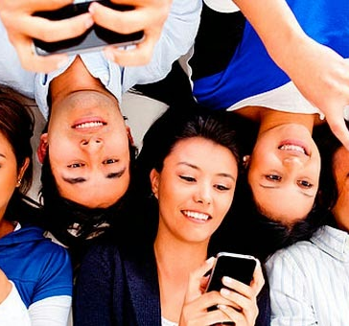
affecting Youth
Serious problem for the baby boomers.
Facebook and Instagram, number one source of distraction.
This Photo by Unknown Author is licensed under CC BY-NC

Slide 10
Conclusion
Results in Higher Productivity
Job Satisfaction
Efficient performance

Slide 11
Thesis
We argue that social interaction and workplace due to social media usage outweighs its negative impacts over memory and thinking skills for the working class.
https://www.youtube.com/watch?v=JN6FSQUnPqk&authuser=0

